Slide 1
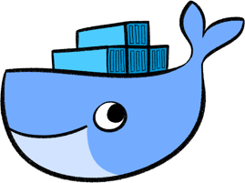
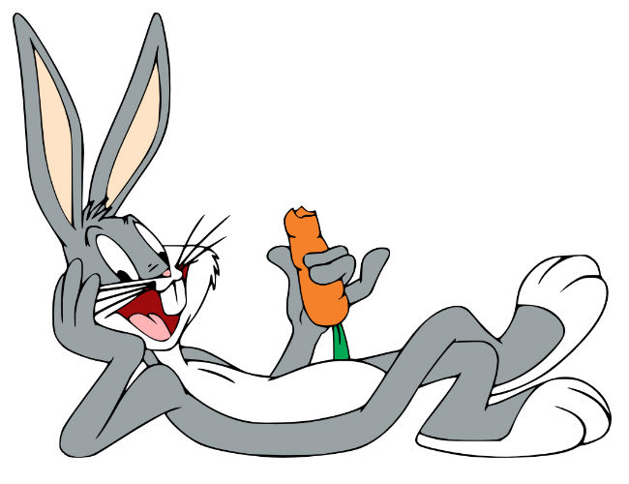
What's up Doc’ker?
Anything Wrong with the slides? Blame this guy.
Balaji Vijayan

Slide 2
What’s Docker?
Docker is a containerization technology. A software which enables us to create containers.
What is a Container?
A Container is a standardized unit of software that packages up libraries, code and other dependencies so that the application can be quickly and reliably run in different environments.
A Docker Image becomes a Docker Container at runtime.

Slide 3
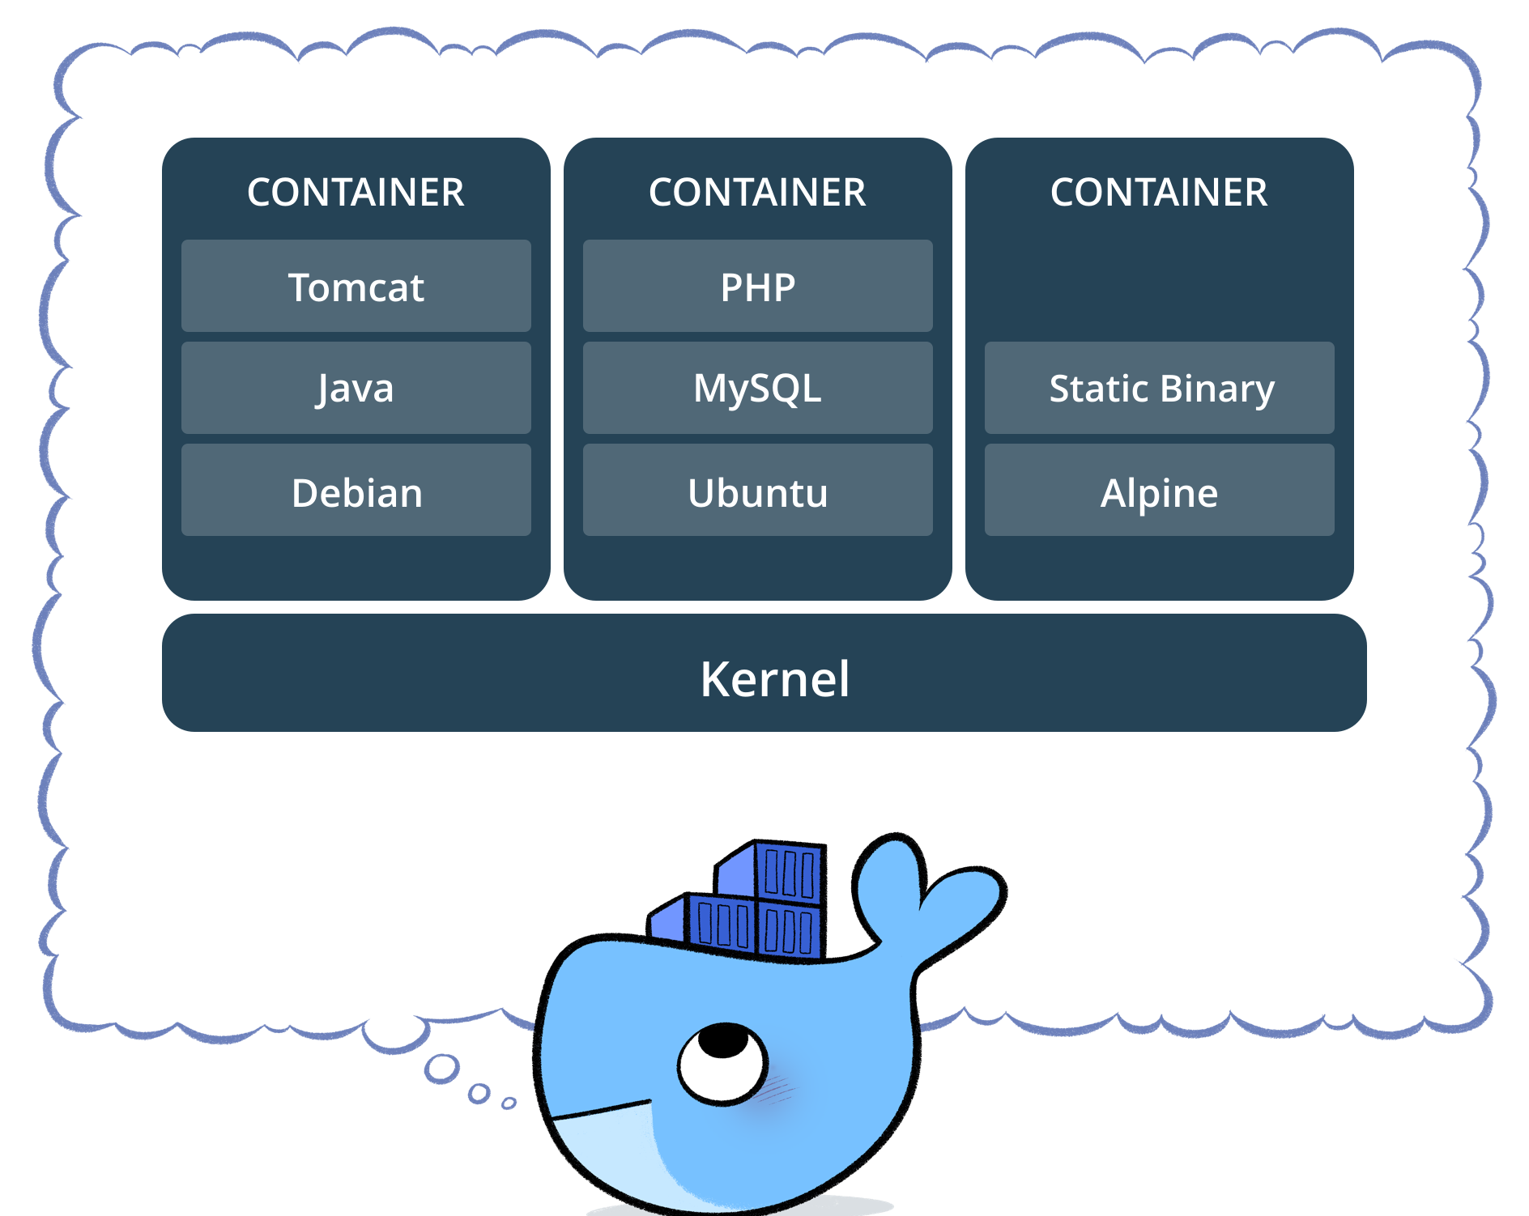

Slide 4
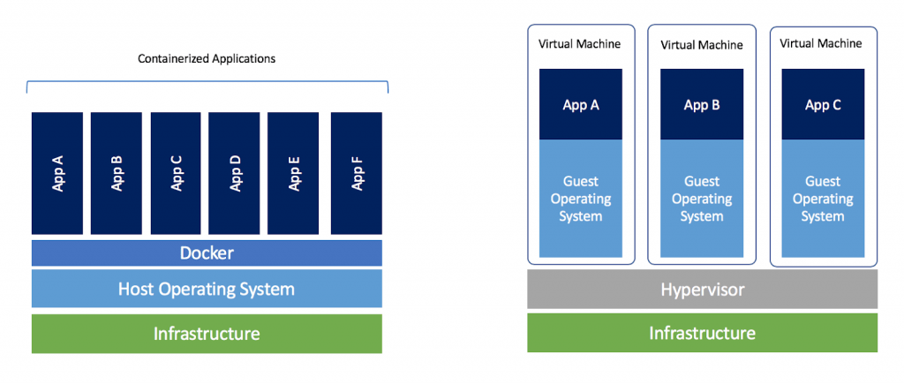
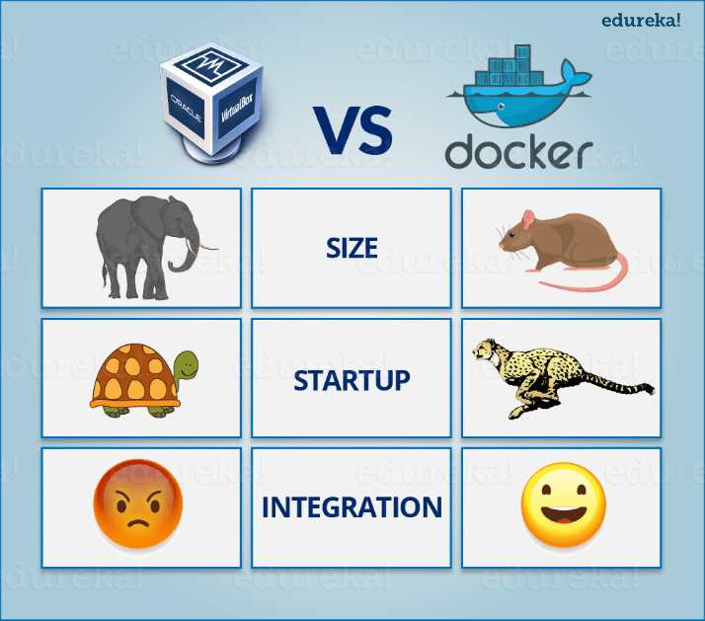

Slide 5

New Bottle Old Wine?
Let’s summon the mighty Duke for answers

Slide 6
Why Docker?
Consistent Environment
Containers give developers the ability to create predictable environments
Run Anywhere
Containers are able to run virtually anywhere, greatly easing development and deployment: on Linux, Windows, and Mac operating systems
Isolation
Containers virtualize CPU, memory, storage, and network resources at the OS-level, providing developers with a sandboxed view of the OS logically isolated from other applications.

Slide 7

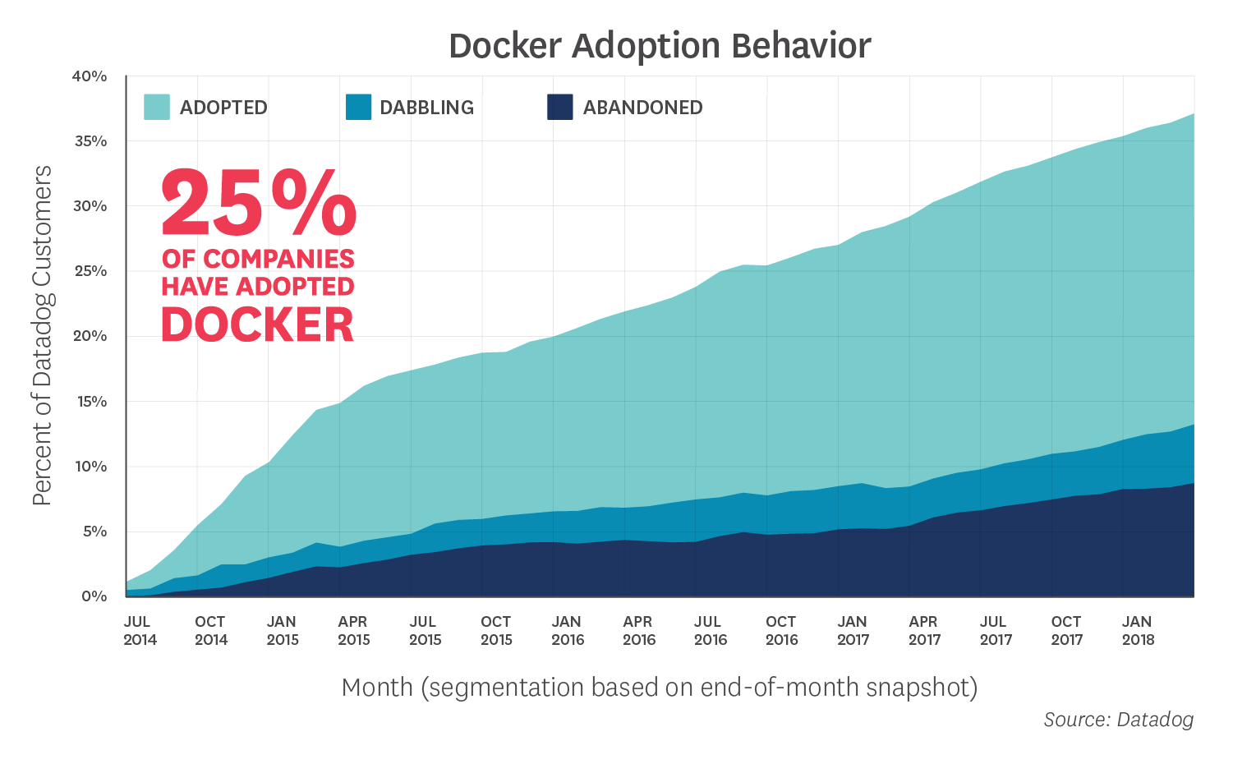
Docker Statistics

Slide 8
Docker Architecture

Slide 9
Docker Container Management
docker run <image>
docker container run <image>
docker container ls –a
docker container run –p 80:80 –d –name <name> <image>
docker container stop <image>
docker container rm <image>
docker container logs <containerId>
docker container logs –f <containerId> //tail the console
docker container top <containerId>
docker container start/stop <containerId>
docker container stats

Slide 10
Docker Container Interaction
docker container run -it --name ubuntu ubuntu
docker container start -ai ubuntu
docker container exec –help
docker container exec -it mysql bash
docker image ls

Slide 11
Docker Pull
Docker Run
Building images with Commit
Docker Start/Stop

Slide 12
Basic Docker File
FROM ubuntu:latest
MAINTAINER Balaji Vijayan
RUN apt-get update && apt-install –y openjdk-8-jdk
CMD [“/bin/bash”]
************************End of File******************************
>docker image build -t jdk-image-from-dockerfile
Docker image build caches the intermediate builds/steps

Slide 13
Docker File References
FROM
MAINTAINER
RUN
COPY
ADD
CMD
ENTRYPOINT
EXPOSE

